Slide 1
ECE 260C, Spring 2025 Routing
Andrew B. Kahng
Thanks to: Bangqi Xu, Matt Liberty, Cho Moon, Eder Monteiro, Zhiang Wang, …
Kahng ECE 260C SP25

Slide 2
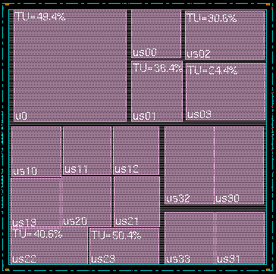
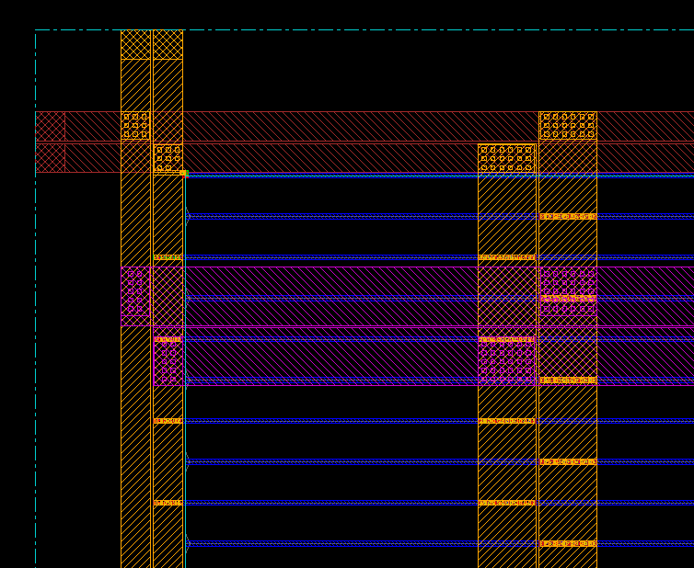
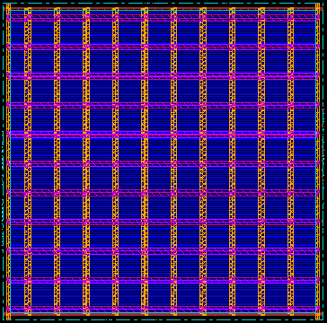
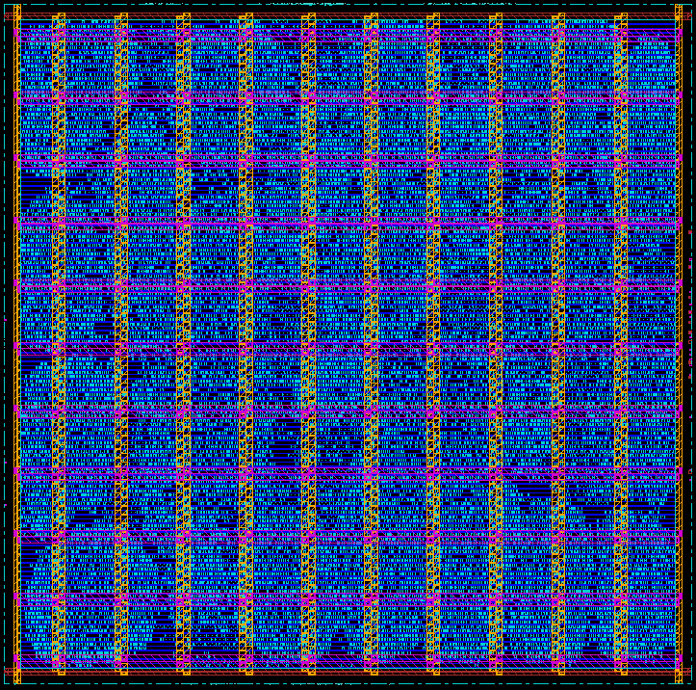
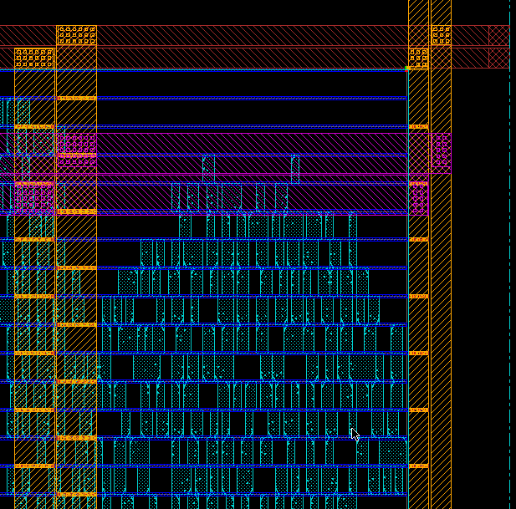
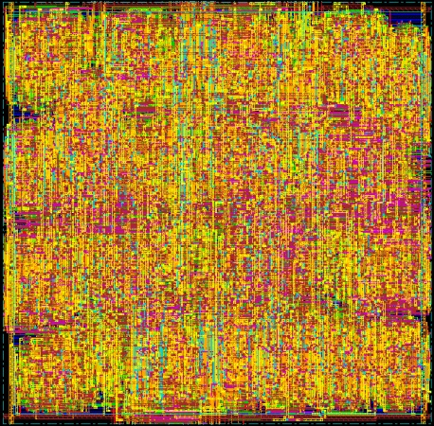
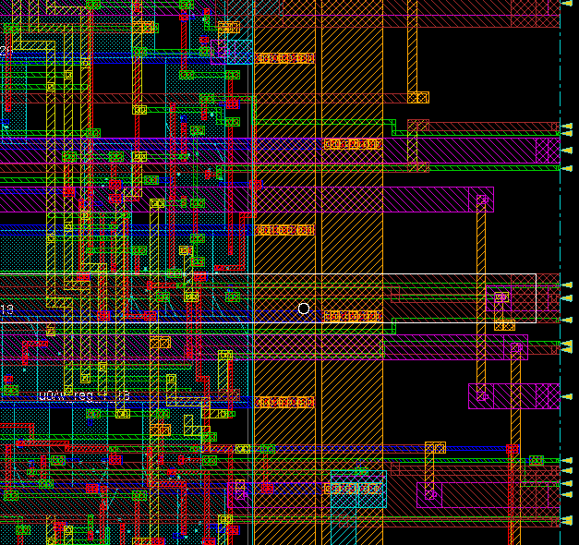
Physical Design Flow Pictures (old ECE 260B slide)
Floorplanning
Powerplanning
Placement
Routing

Slide 3
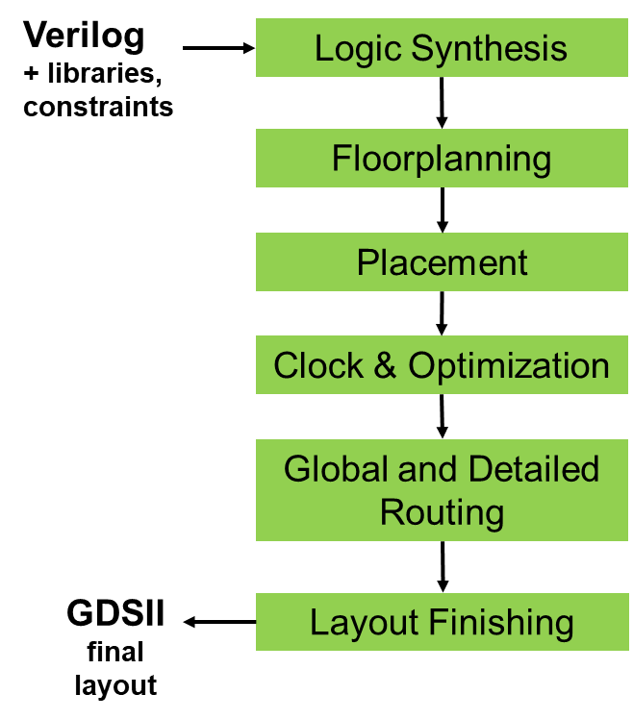
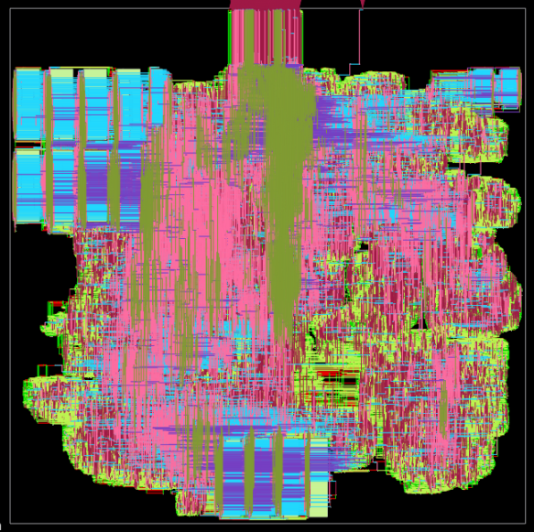
Final (Detailed) Routing
Kahng ECE 260C SP25
Notes:
If we go ahead with routing, here is the final result --

Slide 4
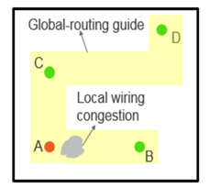
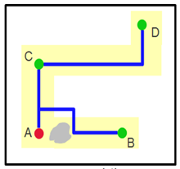
Background
[ICCAD18]
Routing challenges
Complex design rules
Enormous solution space
Physical and circuit considerations
Generic “area routing” flow
Global routing
Produces 3D “route guides”
Detailed routing
Input: route guides = union of gcells
Output: physical nets
Subject to: honoring route guides, honoring design rules
gcell
Blockage-aware
http://www.ispd.cc/contests/18/index.htm
GCell = global routing grid; Global router will only generate gcell-to-gcell connections
Kahng ECE 260C SP25
Thanks: Dr. Bangqi Xu
Notes:
Let’s start with some background in routing.
[Click] Routing challenges, especially for academia, are complex design rules, enormous solution space, physical and circuit considerations. Like I mentioned before, many simplifications or assumptions exist in order to postpone or get rid of the consideration of such challenges.
[Click] A routing flow is usually divided into two stages. [Click] Global routing and [click] detailed routing.

Slide 5
Critical Elements
Must be able to clean up DRC (design rule check) violations !
Without a DRC engine → can’t tell that violations exist !
Without violation filtering → have no clue what to ripup
Major source of violations: naive pin access
On-track access assumption
No inter-cell pin access compatibility check
No accurate modeling of design rules
DRC engine and robust pin access are “scuba tanks”
SCUBA: Self-Contained, Underwater, Breathing Apparatus
Kahng ECE 260C SP25
Thanks: Dr. Bangqi Xu
Notes:
Before we jump into details, let’s take a step back and think about what are the major blockers among all the gaps.
[Click] For the design rule violations that we couldn’t fix before, there are two blockers. One is the absence of a DRC engine, meaning that we have no clue of the existence of violations. The other blocker is that we do not have a violation filtering system, meaning that even we know where the violations are, we still have no clue about what to ripup and reroute.
[Click] Another major gap is pin access. A bad pin access methodology can contribute to a lot of violations with repeating patterns. We used to assume on-track access, no inter-cell pin access interference and we didn’t have accurate modeling of design rules.
[Click] Therefore, a DRC engine and a more robust pin access methodology would be our scuba tanks for the deep diving.

Slide 6
TritonRoute (2018-2022) – Overall Structure
Best academic detailed router for contest benchmarks
Only academic detailed router capable of delivering DRC-clean solution for commercial foundry nodes
TritonRoute
IO
Database
Pin Access
Routing Engine
DRC Engine
Kahng ECE 260C SP25
Thanks: Dr. Bangqi Xu
Notes:
Figure below shows the overall structure of the new TritonRoute, which is, first, the best academic detailed router for contest benchmarks today.
And, second, the only academic detailed router that is capable of delivering DRC-clean solution for TSMC65LP foundry technology node.

Slide 7
Geometry-Based Design Rule Checking for Detailed Routing
Kahng ECE 260C SP25

Slide 8
Motivation
Design rule checking is critical for EDA enablement
New technology has increasingly complex design rules
Mandatory physical verification for signoff
No end-to-end framework for design rule checking in the open literature
→ Missing key enablement for DRC convergence
Work at UCSD:
Optimized data structures for design rule check for detailed routing
Industry-format (LEF) based design rule check methodology
Differentiation between fixable and non-fixable design rule violations for detailed routing
Foundry nodes: confirmed “clean” by commercial DRC tools
Kahng ECE 260C SP25
Thanks: Dr. Bangqi Xu
Notes:
Design rule checking is critical for EDA enablement for new technology nodes. New technology nodes come with increasingly complex design rules. Also, physical verification is mandatory for signoff.
[Click] Many mainstream academic detailed routers claim correct-by-construction or safe-by-construction for design rules including Dr. CU, DRAPS, which is from Brazil and our old TritonRoute work.
[Click] However, these detailed routers, even for contest benchmarks, have hundreds if not thousands of design rule violations. And this implies that without a DRC engine, router simply has no clue what or where to fix violations.
People started research on design rule check more than three decades ago, but the number of publications is amazingly small.
Although there are many handbooks for physical design having routing chapters, there is only one handbook covers low-level geometric algorithms and geometric data structures.
Patents from the industry only describe high-level idea and specific aspects of design rule check.
[Click] To the best of our knowledge, there is no end-to-end framework for design rule checking in the open literature, especially for detailed routing, and this is a missing key enablement for design rule violation convergence
[Click] We propose optimized data structure for design rule checking for the detailed routing. We propose industry format based design rule checking methodology. Our work is the first in the open literature which is capable of differentiating between fixable and non-fixable design rule violations for detailed routing. And we have matching result for both the contest technology node and TSMC65LP technology node as compared to commercial DRC engine.

Slide 9
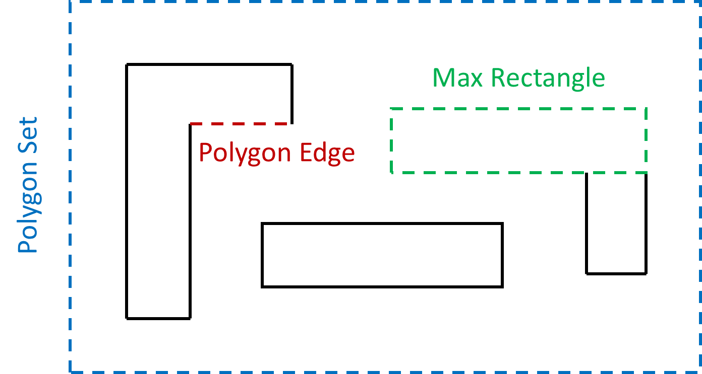
Preliminaries: Basic Geometry Objects
Basic geometry objects in a DRC checking database
Polygon edge
= Edge of a polygon
Max rectangle
= Maximum rectangle inside a polygon
Polygon set
= Union of disjoint polygons
Kahng ECE 260C SP25
Thanks: Dr. Bangqi Xu
Notes:
Let’s find out how we are able to find design rule violation, differentiate between fixable and non-fixable violations. Let’s begin with some preliminaries.
For our geometry-based DRC engine, we have three basic geometry objects in our DRC checking database. Polygon edge, maximum rectangle (or max rectangle) and polygon set.
Figure below illustrates the three basic geometry objects with dashed outlines.

Slide 10
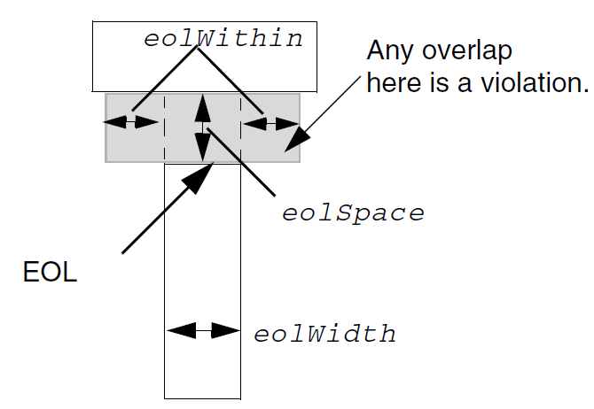
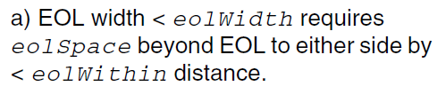
Preliminaries: Design Rule Syntax
Typical design rule can have three components
Spacing value
Intrinsic property condition (optional trigger)
Extrinsic property condition (optional trigger)
Example
Spacing value
Intrinsic property
Extrinsic property
EOL = END-OF-LINE
Kahng ECE 260C SP25
Thanks: Dr. Bangqi Xu
Notes:
A typical design rule can have three components: spacing value, intrinsic property condition and extrinsic property condition
[Click] This example shows a typical end-of-line (or EOL) spacing rule. We can see that it has a spacing value, an intrinsic property and an extrinsic property.
[Click] We are interested in the light-blue rectangle and see whether there is any end-of-line spacing violation with the light-blue rectangle.
[Click] Let’s take the EOL edge, which is the red edge, in the figure as an example. First, we check the intrinsic property of the rule, meaning that whether the length of the EOL edge is less than eolWidth or not. If it is shorter than eolWidth, then the rule applies. The eolWithin helps define the search region, which is the gray area in the figure.
If the EOL edge is shorter than eolWidth, and there is anything within the gray area, then there is violation.

Slide 11
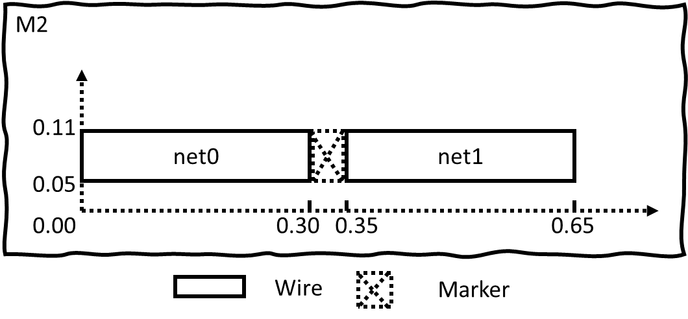
Preliminaries: Design Rule Violation Marker
A design rule violation marker consists of
Bounding box
Layer
Violation net(s)
Design rule
Usage: Give hints to DR where / what to ripup
Example
Rule: SPACING 0.06
→ Object needs to be 0.06 unit away from each other
where
what
why
Marker
Bbox: (0.30, 0.05) – (0.35, 0.11)
Layer: M2
Violation nets: net0 & net1
Design rule: SPACING
Kahng ECE 260C SP25
Thanks: Dr. Bangqi Xu
Notes:
Now that we know how a design rule is typically defined, it’s time to find out how we represent a violation. We use violation marker to represent DRC.
A violation marker has four components. The bounding box and layer, [Click] which tell us where the violation is. [Click] And the violating nets, which tell us what is violating the design rules. [Click] Last, the design rule itself tells us why there is a violation.
[Click] With the violation maker, we can provide hints to the detailed router about where and what to ripup
[Click] Here is an example. We have a simple spacing rule saying that any object needs to be 0.06 unit away from each other. However, we can see that the spacing between net0 rectangle and net1 rectangle is only 0.05 which is less than the required spacing value. Therefore, there is a design rule violation.
[Click] The corresponding marker would look like this. The bounding box and layer tells us the location of the violation. Violating nets tell us what nets are involved in the violation and design rule tells us what rule is being violated.

Slide 12
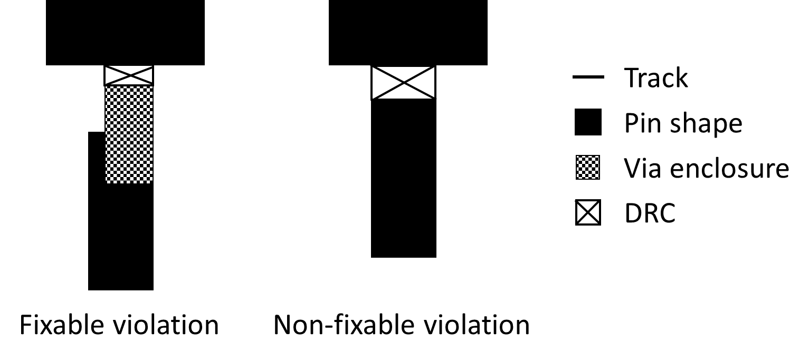
Preliminaries: Fixable and Non-Fixable DRC
Knowing locations of DRCs is not enough
DRC could happen inside standard cell itself
DRC could happen between PG stripes
→ DR cannot help resolve such non-fixable DRCs
Need to filter DRCs before give them to DR
I.e., only provide DR with fixable DRCs
Example
Kahng ECE 260C SP25
Thanks: Dr. Bangqi Xu
Notes:
The last part of preliminaries is fixable and non-fixable DRC.
Only knowing the locations of the violations is not enough because design rule violations could happen inside the standard cell itself or violations could happen between power and ground nets. Detailed router would not be able to help with such cases. Therefore, such violations are non-fixable violations. [Click] One of our key contribution in this work is to filter out such non-fixable violations before we hand the violation report to the detailed router.
[Click] These two figures illustrate the difference between fixable violation and non-fixable violation. In the left figure, the violation happens between a via and pin shape. The via is dropped by the detailed router. Therefore, in this case, if we ripup the via, we may be able to fix the violation.
However, in the right figure, the violation happens between pin shapes. Since detailed router cannot change the pin shapes of a standard cell, it is a non-fixable violation.

Slide 13
Problem Statement
Goal: Given layout objects, find fixable design rule violations (if any)
Inputs
Design layout database
Design rules
Constraints
Design rule checking bounding box
Layer range (e.g., M2-M5)
Output
Fixable design rule violation markers
Kahng ECE 260C SP25
Thanks: Dr. Bangqi Xu
Notes:
With the knowledge of the preliminaries, now let’s define the design rule check problem.
The goal is that, given layout objects, we would like to find the fixable design rule violations if there is any.
[Click] The inputs of the problem are the design layout database and the design rules.
[Click] To allow a finer granularity of design rule checking, in this work, we support region-based design rule check by taking a bounding box and layer range as additional constraints
[Click] The output is a list of markers for fixable design rule violations.

Slide 14
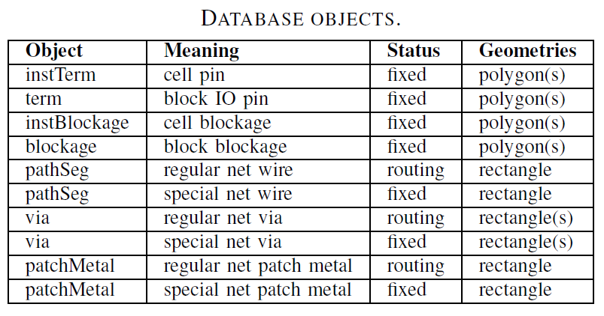
Database Objects
Kahng ECE 260C SP25
Thanks: Dr. Bangqi Xu
Notes:
This slide summarizes the objects in the design layout database. One key information in the table is that the polygons are decomposed into max rectangles before we start the checking process.
[Click] Another important information in the table is that objects are either routing or fixed. This is the property that we rely on to differentiate between fixable and non-fixable violations.

Slide 15
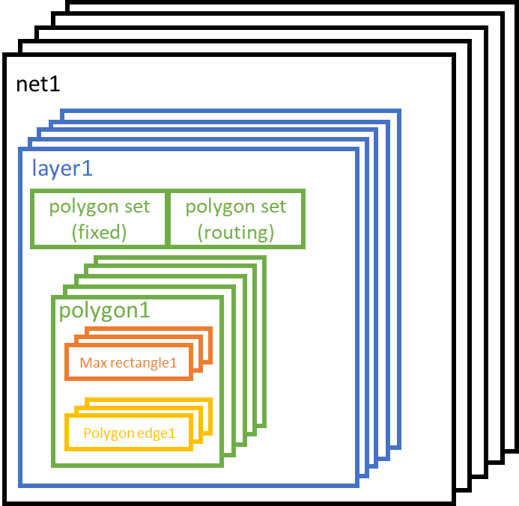
Data Structure
Object (fixed) & object (routing)
→ Key for fixable / non-fixable differentiation
Polygon set (fixed)
Union of fixed obj. shapes
Polygon set (routing)
Union of routing obj. shapes
DRC checking database
Kahng ECE 260C SP25
Thanks: Dr. Bangqi Xu
Notes:
In this slide, I will present the data structure. Each object in the DRC checking database has a flag to indicate whether it is fixed or routing. And again, this is the key for fixable / non-fixable violation differentiation.
[Click] We use the lookup table here to assign the routing / fixed property when we populate the DRC checking database using the objects from the design layout database.

Slide 16
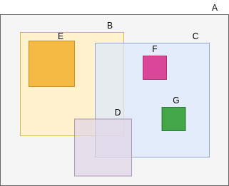
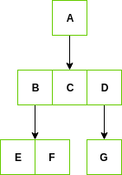
Region Query
RTree as underlying container
Two RTrees for each layer
MaxRect RTree
Edge Rtree
Each maxRect / Edge has property indicating whether it is fixed or routing
Layout
RTree Representation
Kahng ECE 260C SP25
Thanks: Dr. Bangqi Xu
Notes:
Based on the DRC checking database, we use RTree as the underlying container to enable region query.
[Click] For each layer, we build two RTrees, one for max rectangles and the other for edges. Different design rules may need either or both of the RTrees.
[Click] As we have seen in the previous slide, each max rectangle and edge has the property to indicate whether it is fixed or routing

Slide 17
High-Level Flow for DRC Check (Single Obj.)
Design Rule
MaxRect / Edge
No
Meet intrinsic
property?
Yes
Triggering condition check
No
Meet extrinsic
Property?
Yes
Region query using
spacing value
No
< spacing?
Spacing condition check
Yes
Yes
Fixed?
No
Fixable violation differentiation
Return clean
Return DRC marker
Kahng ECE 260C SP25
Thanks: Dr. Bangqi Xu
Notes:
This slide shows the high-level flow for DRC check for a single object.
Given a design rule and the object we want to check, [Click] we first check whether the intrinsic and extrinsic properties are satisfied. If not satisfied, the rule is not triggered, and we say it is clean.
If the rule is triggered, we then perform region query based on the spacing value to query potential violating objects. [Click] If the distance between the objects is indeed shorter than required spacing value, it is a violation. Last, we need to recognize whether it is fixable violation or not. [Click] We check the fixed / routing property of the objects involved in the violation, and we only return a violation marker if at least one party involved in the violation is a routing object.

Slide 18
Design Rules Types
Design rules are divided into two categories
→ Metal layer and Cut layer
Metal layer rules
Metal short
Non-sufficient-metal-overlap
Parallel run length (PRL) spacing
Minimum width
Minimum step
End-of-line (EOL) spacing
Cut layer rules
Cut short
Cut spacing
Metal Spacing Rule
Metal Shape Rule
Many more design rule types in advanced technologies! See the “LEF5.8” standard, e.g., here.
Kahng ECE 260C SP25
Thanks: Dr. Bangqi Xu

Slide 19
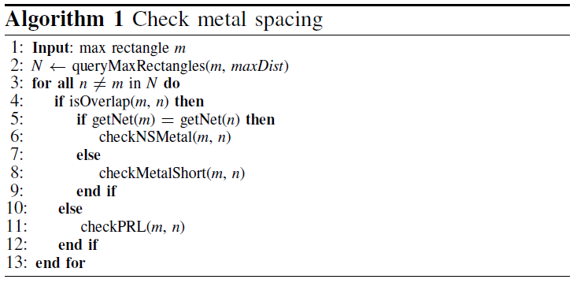
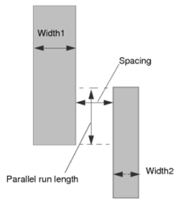
Metal Spacing Checking
https://www.ispd.cc/contests/19/Introduction_of_ISPD19_Contest_Problem.pdf
Kahng ECE 260C SP25
Thanks: Dr. Bangqi Xu

Slide 20
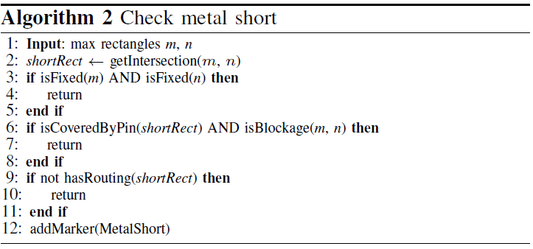
Short Checking
Kahng ECE 260C SP25
Thanks: Dr. Bangqi Xu

Slide 21
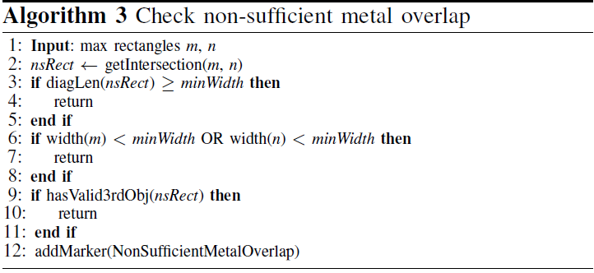
NS-Metal Checking
Kahng ECE 260C SP25
Thanks: Dr. Bangqi Xu

Slide 22
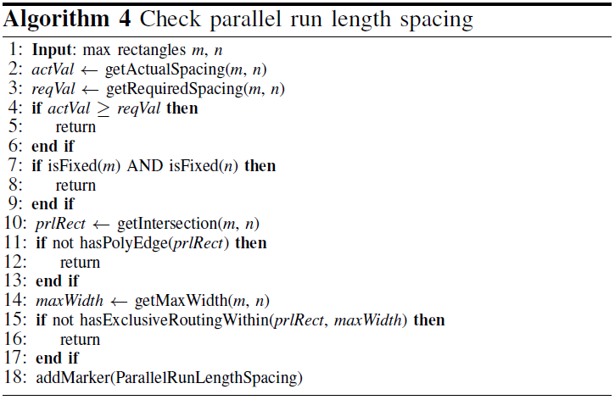
PRL Spacing Checking
Kahng ECE 260C SP25

Slide 23
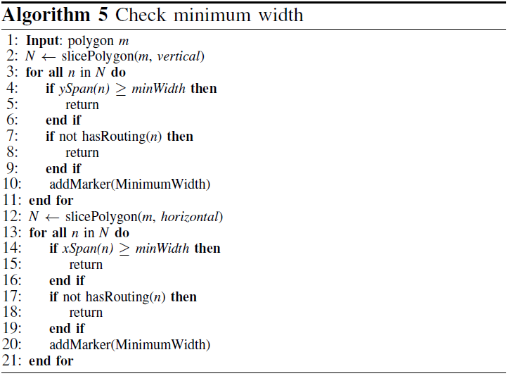
Min Width Checking
Kahng ECE 260C SP25
Thanks: Dr. Bangqi Xu

Slide 24
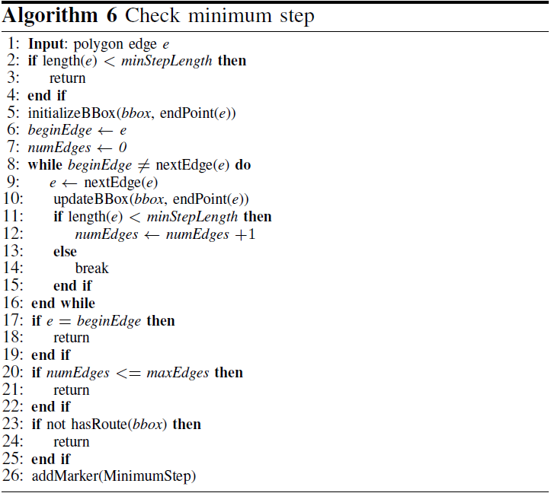
Min Step Checking
Kahng ECE 260C SP25
Thanks: Dr. Bangqi Xu

Slide 25
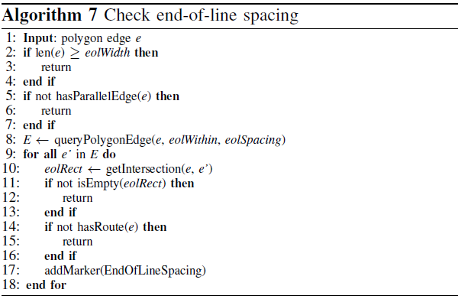
EOL Spacing Checking
Kahng ECE 260C SP25
Thanks: Dr. Bangqi Xu

Slide 26
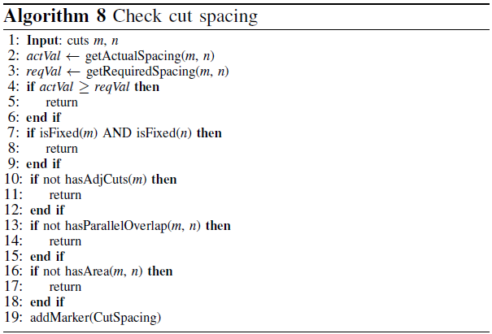
Cut Spacing Checking
Kahng ECE 260C SP25
Thanks: Dr. Bangqi Xu
Notes:
Remind at end about the good results …

Slide 27
Dynamic Programming-Based Multi-Level Pin Access Analysis
Kahng ECE 260C SP25

Slide 28
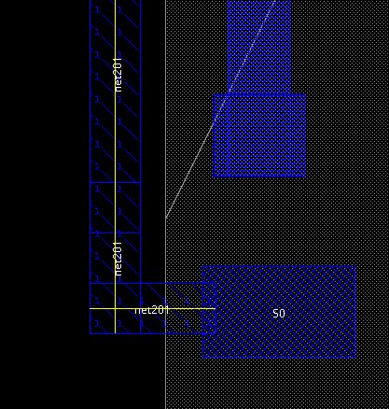
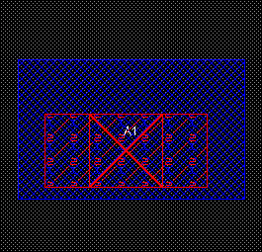
Motivation
Pin access = wire / via connection to access a pin
Critical to decrease DRCs in detailed routing
→ Failure results in repeating violation patterns
Need robust & scalable pin access analysis (!)
Wire access
Via access
Kahng ECE 260C SP25
Thanks: Dr. Bangqi Xu
Notes:
Pin access defines the way we make connection to a pin. We can access a pin by either connecting a wire to the pin or drop a via on the pin. The left figure illustrates a wire access where the yellow lines indicate the wire connection and the right figure shows a via access. In most technologies, via access is the preferred way for pin access. In this work, our focus is on via access.
[Click] Pin access is critical to decrease DRCs in detailed routing. As you can imagine, failure in pin access would result in repeating violation patterns since the mistake would be copied everywhere.
[Click] Therefore, a pre-routing, robust and scalable pin access analysis is a very important building block towards a DRC-clean routing solution.

Slide 29
Previous Works / Our Work
Existing work [Han15] assumes on-track access
Usually assume alignment between routing track and placement site
→ Not always true (ISPD18/19 contests)
LUT-based abutting cell pair analysis [Xu16]
→ Not scalable (> 10M combinations)
Our work:
Robust pin access point enumeration
Boundary conflict-aware access pattern enumeration
Dynamic programming-based access pattern selection for standard cell instance cluster
Kahng ECE 260C SP25
Thanks: Dr. Bangqi Xu
Notes:
Existing works usually assume on-track pin access. Also, they usually assume alignment between routing track and placement site. However, such assumptions do not always hold as we can see from the contest benchmarks.
[Click] Other work proposes lookup table-based pin access analysis for abutting cell pairs. However, such approach is not scalable since for a standard cell library with reasonable size, using their approach could easily end up having more than 10 million combinations.
[Click] In this work, we proposed a robust pin access point enumeration, followed by boundary conflict-aware access pattern generation. We apply dynamic programming-based access pattern selection for cluster of standard cell instances

Slide 30
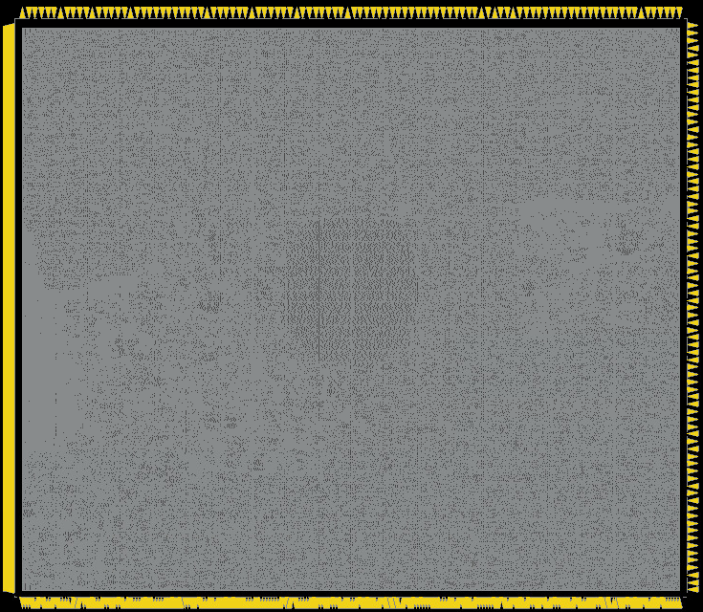
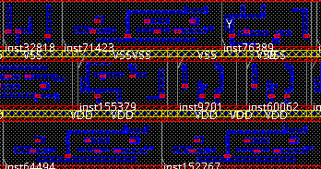
What Does Pin Access Analysis Do?
Testcase: ISPD18_test10
290K standard cell instances
992K nets
DRC clean pin access pattern selection in 241s
Zoomed-in region
(red dots are via access locations)
Whole design layout
Kahng ECE 260C SP25
Thanks: Dr. Bangqi Xu
Notes:
First let’s take a look at what pin access analysis actually does on a design level. We use the largest testcase in the contest benchmark suite as an example. The testcase has 290K standard cell instances and 992K nets.
[Click] We can see that for each instance in the design, we are able to give mutually DRC-clean pin access solution in around 4 minutes with single thread. The red dots in the right figure indicate the via access for each pin.

Slide 31
How to Find Such Access Points?
Multi-level hierarchical pin access analysis
Unique instance pin level
Unique instance level
Instance cluster level
Scalable memory usage
On-demand design-based analysis
Scalable runtime
DRC check on the fly
→ More than 2M DRC engine calls in
8min with single thread
Cluster-based access pattern selection
Unique instance-based access pattern generation
Pin-based access point generation
Kahng ECE 260C SP25
Thanks: Dr. Bangqi Xu
Notes:
Since we know the approach is scalable and robust, let’s find out how it actually works.
In this work, we propose a multi-level hierarchical pin access analysis. The bottom level is unique instance pin level, the middle level is unique instance level and the top level is instance cluster level. I will give more details on unique instance in the next slide.
[Click] Our approach has very scalable memory usage since we perform the analysis on demand.
[Click] Also, our approach is very scalable thanks to the robust DRC engine. In our experiment, more than 2 million DRC engine calls can be done within 8 minutes using single thread.

Slide 32
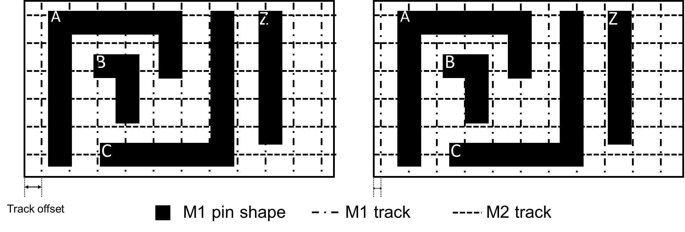
Unique Instance
To address track-placement site misalignment
Defined by a signature consisting of
Cell master (e.g., BUFFX4)
Orientation
Offsets to all track patterns
Two cell instances point to the same unique instance if they share the same signature
Two different unique instances due to M1 track offset
Kahng ECE 260C SP25
Thanks: Dr. Bangqi Xu
Notes:
In the last slide, we mentioned unique instance, now I will give more details on it.
The concept is proposed to address the routing track and placement site misalignment.
[Click] Each unique instance is defined by a signature consisting of the following three components. The cell master (for example BUFFX4), the orientation and the offsets of track patterns.
[Click] Two cell instances would point to the same unique instance if they have the same signature.
Figure below shows two unique instances. Although they are from the same cell master and have the same orientation, but they are considered as two unique instances because they have different M1 track offsets.

Slide 33
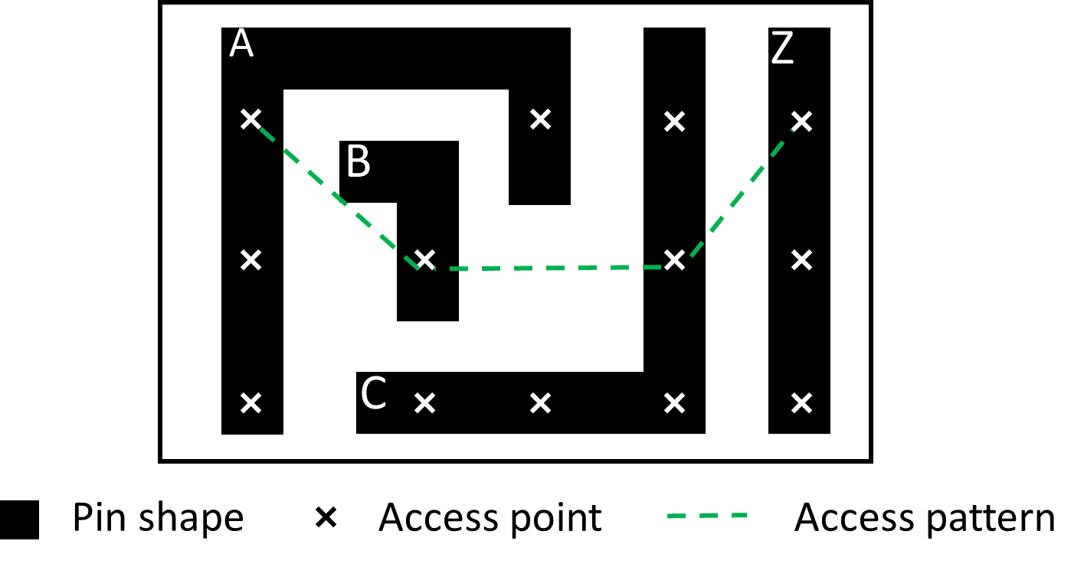
Definitions
Access point (for a pin)
A location (x, y, layer) that detailed router (DR) can make route to
Valid access point
An access point that allows DRC-clean routing
Valid access pattern: combination of mutually DRC-clean access points (one access point per pin)
Kahng ECE 260C SP25
Thanks: Dr. Bangqi Xu
Notes:
This slide gives the definitions we use in this work.
An access point for a pin is the location (x, y, and layer) that detailed router can make route to. As mentioned before, via connection to a pin is usually preferred.
[Click] A valid access point is an access point that allows DRC-clean routing.
[Click] A valid access pattern is a combination of mutually DRC-clean access points where each pin has one access point. A valid access pattern is composed of the access points along the green dashed line.

Slide 34
Access Point Quality Assessment
Goal: an evaluation system compatible with a broad range of technology nodes
Four coordinate types
Quality of an access point = sum of coordinate type costs for both x and y coordinates
Type | Cost
On-track | 1
Half-track | 2
Shape-center | 3
Enclosure boundary | 4
Kahng ECE 260C SP25
Thanks: Dr. Bangqi Xu
Notes:
(any precedent?)

Slide 35
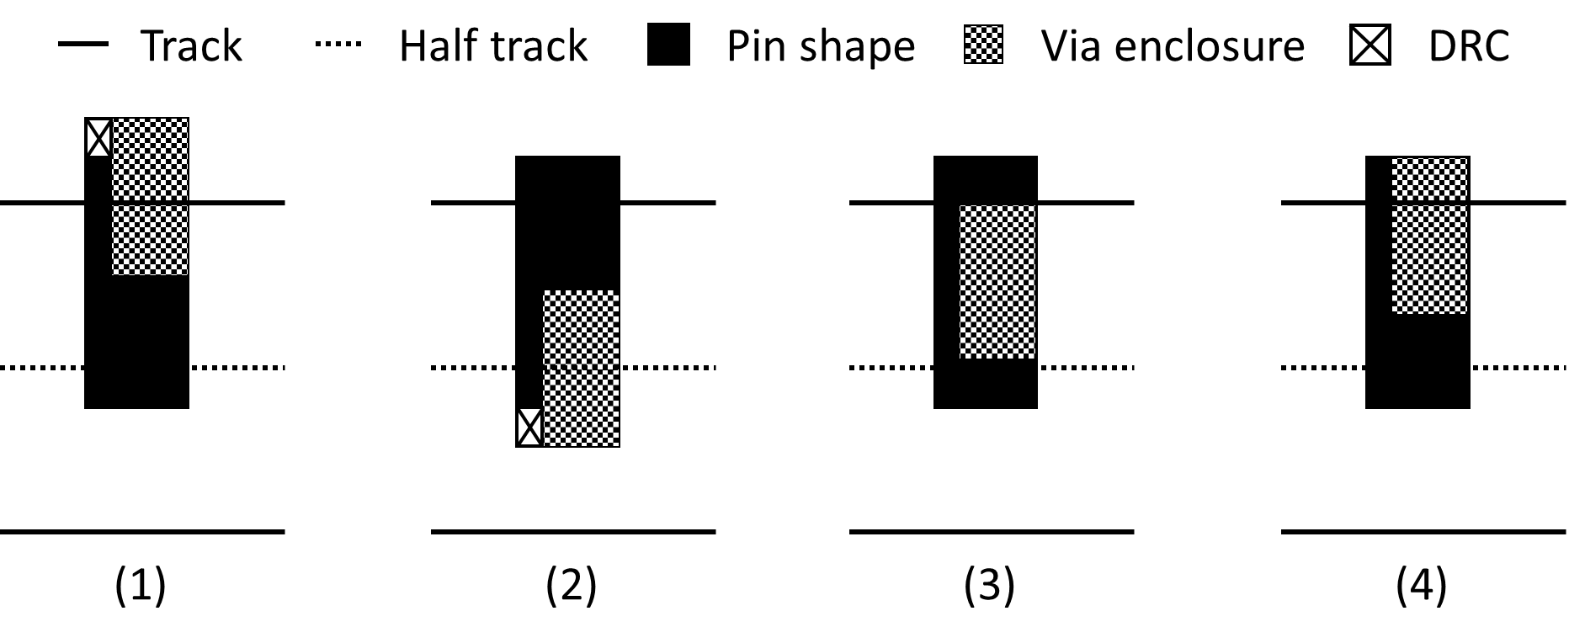
Coordinate Types
On-track: On preferred and non-preferred routing track of upper layer
Half-track: At midpoint between two neighboring routing tracks
Shape-center: At midpoint between left and right (or top and bottom) coordinates of a rectangular pin shape
Enclosure boundary: Via enclosure aligns with pin shape boundary
Illustration of y-coordinate types
Kahng ECE 260C SP25
Thanks: Dr. Bangqi Xu
Notes:
Different technology and standard cell libraries can have standard cell design with widely different characteristics. In order to make the pin access analysis robust, we propose the four following coordinate types with their corresponding cost. The coordinate type with lower cost is preferred.
In the figures below, we illustrate the four coordinate types using y-coordinate.
[Skip if ROOT] Via enclosure is the metal part of a via that is shown in dotted texture. For on-track coordinate, we can see that the y-coordinate of the via center is aligned with routing track. For half-track coordinate, the y-coordinate of the via center is aligned with the midpoint of the two neighboring routing tracks. For shape-center coordinate, the y-coordinate of the via center is aligned with the midpoint of top and bottom edge of the pin rectangle. And for the enclosure boundary, the via enclosure aligns with pin shape boundary.
In case on-track and half-track have design rule violations as shown in the figures, we would prefer to use the coordinate types with higher cost since DRC clean is the first priority.

Slide 36
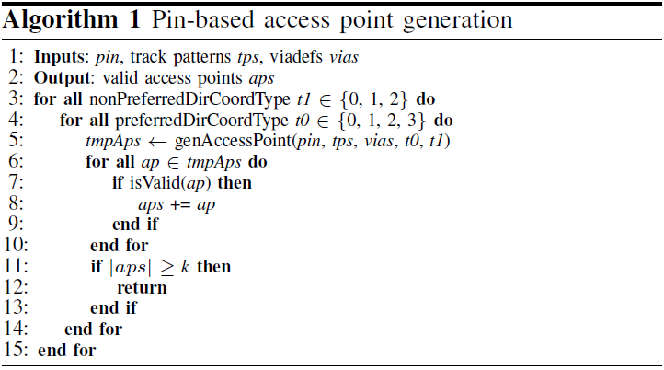
Pin-Based Access Point Generation
Kahng ECE 260C SP25
Thanks: Dr. Bangqi Xu
Notes:
This slide shows the procedure to generate access points for a unique instance pin.
[Skip if ROOT] For each coordinate type along x and y directions, we enumerate access point and validate with DRC engine. If an access point is DRC-clean, then we push it to the return list. A threshold k can be tuned to balance between robustness and runtime.

Slide 37
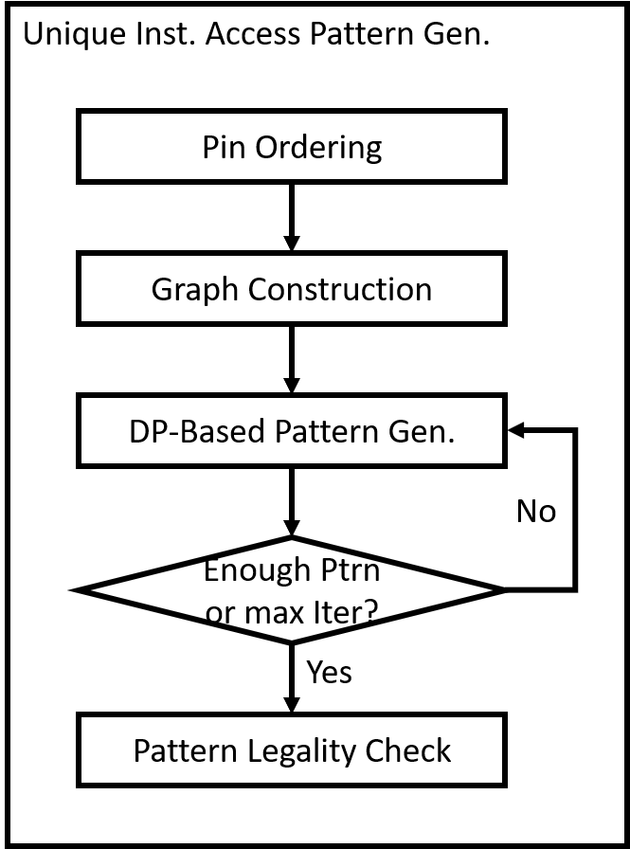
Unique Instance-Based Access Pattern Generation
Input
Valid access points of pins in a unique instance
Output
Valid access patterns
Kahng ECE 260C SP25
Thanks: Dr. Bangqi Xu
Notes:
Now that we have generated access points for each unique instance pin, it’s time to generate access patterns for a unique instance.
We take the valid access points of pins in a unique instance as inputs, and we generate valid access patterns for the unique instance using the flow shown in the figure.
[Skip if ROOT] We first order the pins in the unique instance. Then, we construct a pin access graph based on the pin orders. Using the graph, we iteratively generate different access patterns until we have enough access patterns, or a max iteration number is reached. Last, we use DRC engine again to check the legality of the pattern.

Slide 38
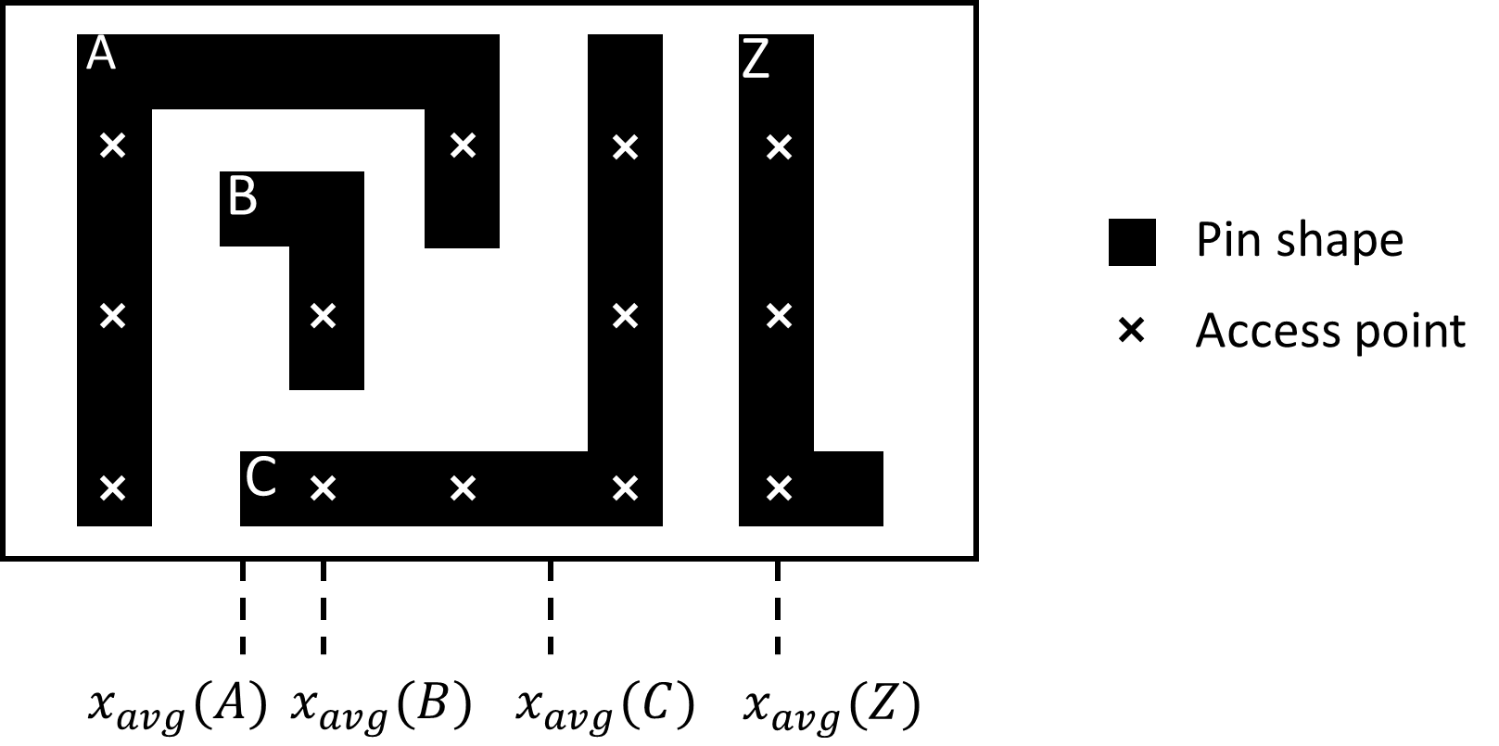
Pin Ordering
Sort pins according to their average x coordinate of valid access points
Idea: neighbors in sorted pin list are more likely to have conflicts due to DRC
I.e., pin A and pin B are more likely to have conflict compared to pin A and pin C
Kahng ECE 260C SP25
Thanks: Dr. Bangqi Xu
Notes:
In the pin ordering step, we sort pins according to their average x coordinate of valid access points.
[Click] The idea behind the sorting metric is that neighbors in the sorted pin list are more likely to have conflicts due to violations. For example, pin A and pin B are more likely to have conflict compared to pin A and pin C.

Slide 39
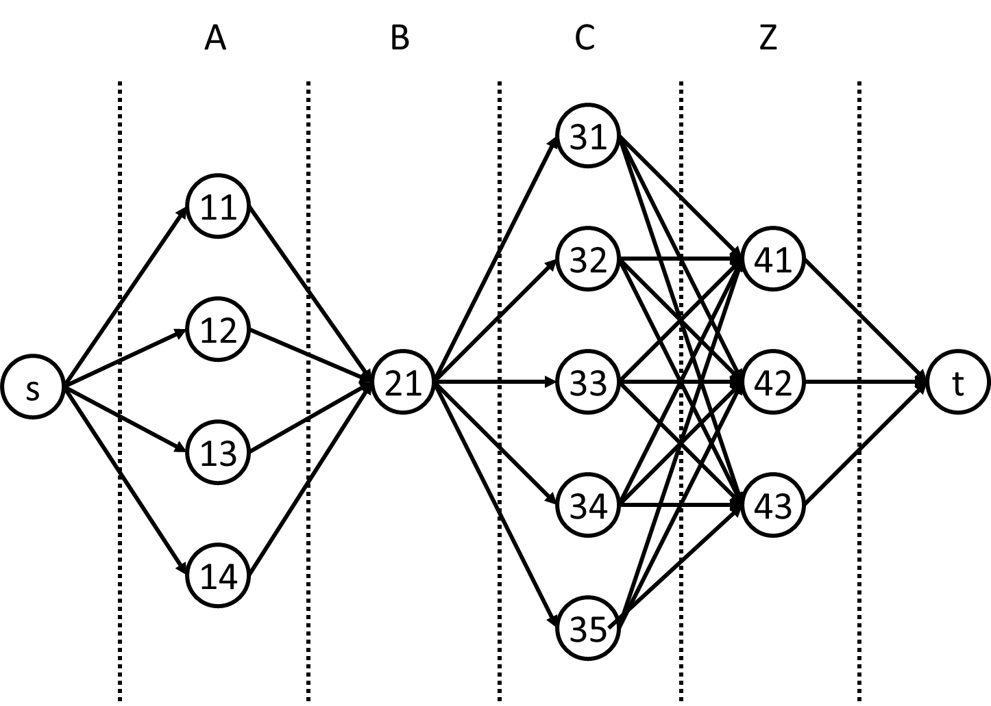
Graph Construction
Vertex = access point
Marked with pin index and access point index
E.g., 23 means the third access point of the second pin
s and t are virtual start and end points
Pin correspond to a “group” of vertices in graph
Edge exists between pair of access points from neighboring groups, weighted by physical distance
Access pattern = path from s to t
Kahng ECE 260C SP25
Thanks: Dr. Bangqi Xu
Notes:
After the pin ordering, we build a graph for access pattern generation.
Each vertex is a valid access point marked with pin index and access point index. For example, 23 means the third access point of the second pin.
We introduce virtual start and end vertices.
[Click] Each pin corresponds to a “group” of vertices in the graph. [Skip if ROOT] In the graph below, we can see different groups of vertices are separated by dashed lines and each group of vertices correspond to access points of a pin.
[Click] Edge exists between pair of access points from neighboring groups, weighted by the physical distance between them.
[Click] A path from s to t represents an access pattern. In our implementation, we use dynamic programming to find the shortest path between s and t.

Slide 40
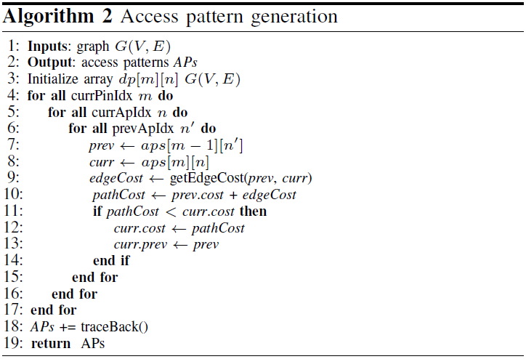
Dynamic Programming-Based Pattern Generation
Kahng ECE 260C SP25
Thanks: Dr. Bangqi Xu

Slide 41
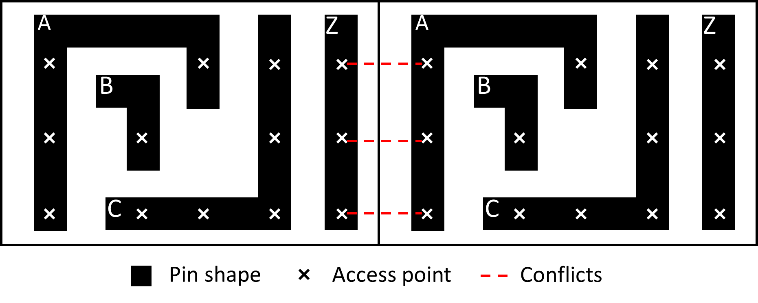
Iterative Edge Penalty Method
Inter-cell pattern conflicts between cell-boundary pins
→ Need to encourage to choose different boundary pin access point
Solution: add penalty cost to boundary pin access points if they have been selected in existing pattern
Kahng ECE 260C SP25
Thanks: Dr. Bangqi Xu
Notes:
One access pattern for a unique instance is usually not enough. The reason is that inter-cell pattern conflicts between abutting cells happen a lot as shown in the figure below.
Therefore, we need to have more than one access pattern for each unique instance and we want to encourage to use different access points for pins near the cell boundary.
[Click] Our solution is to add penalty cost to boundary pin access points if they have been already selected in existing patterns before

Slide 42
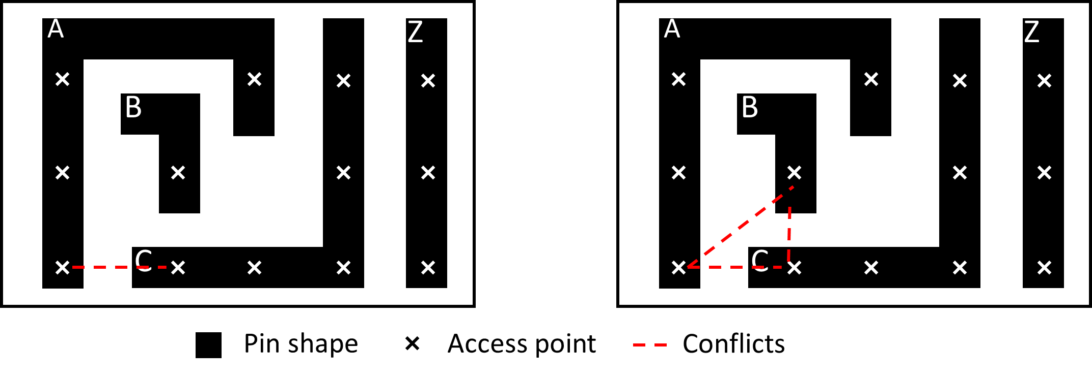
Pattern Legality Check
Use DRC check engine to validate access pattern
Violation can occur between non-neighboring pins
Some design rules check multiple objects (access points)
Only DRC-clean patterns will be seen in next stage
(i)
(ii)
Kahng ECE 260C SP25
Thanks: Dr. Bangqi Xu
Notes:
After iteratively generating different pin access patterns, we still need to perform final legality check using DRC engine to validate. The reason is that violation could occur between non-neighboring pins in the graph which would not be captured by the edge cost.
Moreover, there exist design rules that can involved more than two access points.
[Click] Only DRC-clean patterns will be handed to the next stage.

Slide 43
Cluster-Based Access Pattern Selection
Inputs
Instances in a cluster (of the same row)
Access patterns of each unique instance
Map from instance to corresponding unique instance
Output
Access pattern for each instance in the cluster with minimized overall cost
Access Pattern Sel.
Inst Ordering
Graph Construction
DP-Based Pattern Sel.
Kahng ECE 260C SP25
Thanks: Dr. Bangqi Xu
Notes:
Now that we have generated access patterns for every unique instance, it’s time to see how we can select among those patterns.
The input of the problem is instances in a cluster, and they should be from the same cell row. Also, we have the access patterns of each unique instance and we know the mapping from each instance in the cluster to their corresponding unique instances.
The output of the problem is access pattern for each instance in the cluster with minimized overall cost (ideally they should be DRC clean)
We achieve this following the flow in the figure. The procedure is similar to the access pattern generation. [Skip if ROOT] We first order the instances in the cluster. Then, similar to the access pattern generation, we construct a graph for dynamic programming. Last, we select access patterns using dynamic programming to find the shortest path.

Slide 44
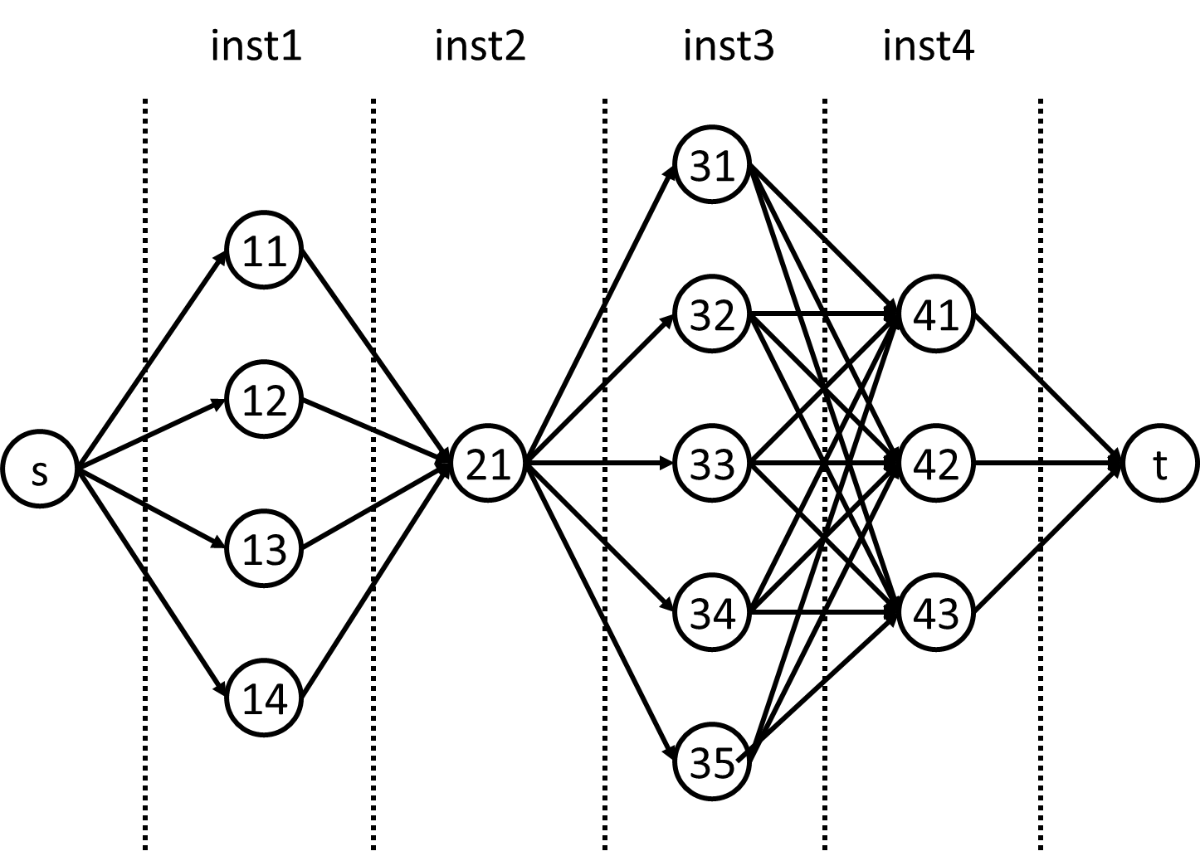
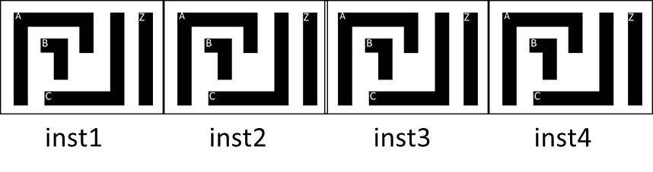
Cluster-Based Access Pattern Selection
Instance ordering
Sort instances in the cluster according to x coordinate of the lower-left corner
Graph construction
Vertex = access pattern
Shortest path from s to t is the best pattern combination
DP formulation
Similar as previous formulation
No iteration
Kahng ECE 260C SP25
Thanks: Dr. Bangqi Xu
Notes:
We sort the instances in a cluster according to their x coordinates. [Skip if ROOT] In the figure below, the four instances are sorted as inst1, inst2, inst3 and inst4.
[Click] We build a graph where the vertices are valid access patterns as shown in the graph. The shortest path from s to t is the best pattern combination for the cluster.
[Click] We use a dynamic programming-based formulation to find the shortest path. The formulation is similar to the one we use for access pattern generation, but this time without iteration.

Slide 45
CTS
Kahng ECE 260C SP25

Slide 46
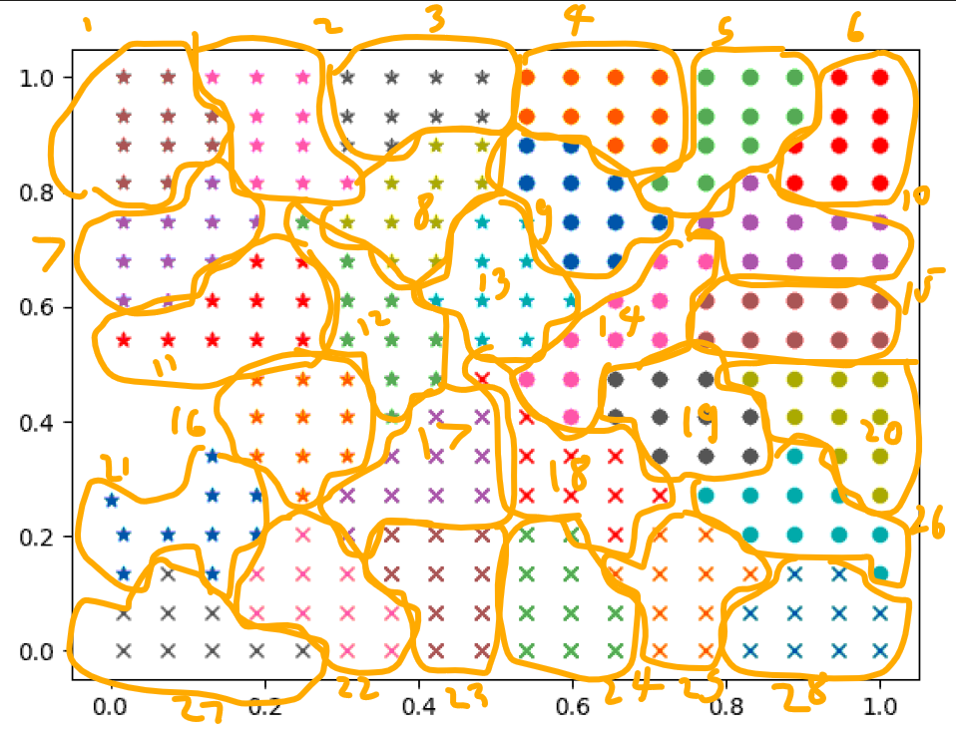
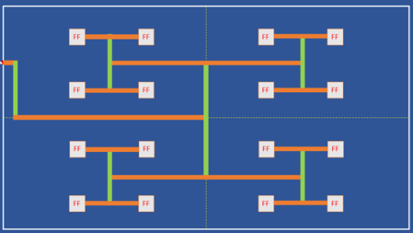
CTS Main Steps
Sink clustering
Sequential elements are grouped into a fixed number of clusters based on their locations
Tree construction and balancing
Buffers are inserted based on some structure, e.g., hierarchical H-Tree
Tree lengths are balanced such that clock skews are minimized
LDRC (electrical rules) repair
LDRC violations are repaired during or after CTS
Max transition, max capacitance, max wire length, etc.
Kahng ECE 260C SP25
Thanks: Dr. Cho Moon, Precision Innovations

Slide 47
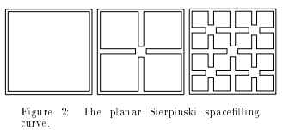
Sink Clustering
Group sequential elements based on their locations to produce the best results (e.g., minimum wire length)
These parameters can be specified manually or determined automatically
Cluster size
Cluster diameter
All elements in the cluster will be driven by the same buffer
Early “TritonCTS” versions used spacefilling curves to perform sink clustering !
https://vlsicad.ucsd.edu/Publications/Conferences/32/c32.pdf
Kahng ECE 260C SP25
Thanks: Dr. Cho Moon, Precision Innovations

Slide 48
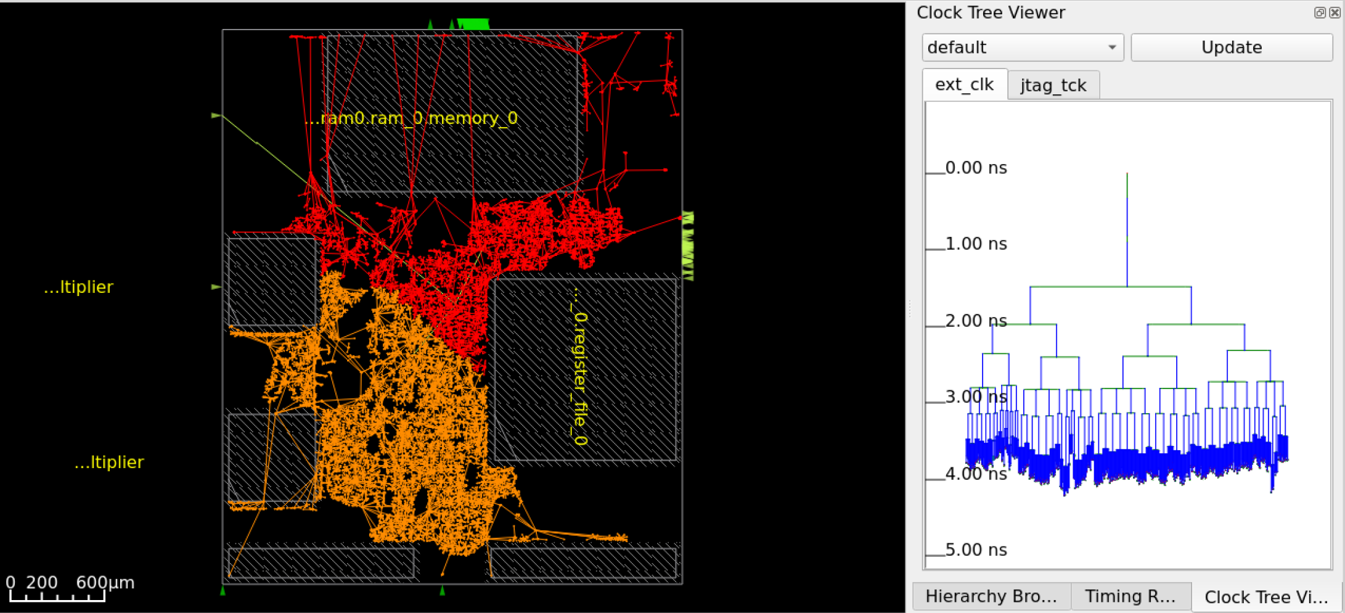

Obstruction-Aware CTS
Clock buffers should not be placed on top of macros, placement blockages or another clock buffers
Detailed placement may displace “illegal” buffers and cause timing to change after CTS
New “legal” buffer locations need to preserve balanced clock tree
Obstruction-aware CTS can reduce legalizer displacement by up to 4X
sky130hd/microwatt without obstruction-aware CTS
sky130hd/microwatt with obstruction-aware CTS
Kahng ECE 260C SP25
Thanks: Dr. Cho Moon, Precision Innovations

Slide 49
OpenROAD CTS Commands
Command | Description | Example Output
clock_tree_synthesis | Build a balanced Htree by choosing appropriate clock buffers | [INFO CTS-0050] Root buffer is BUF_X4. [INFO CTS-0051] Sink buffer is BUF_X4. [INFO CTS-0052] The following clock buffers will be used for CTS: BUF_X4 . . . [INFO CTS-0017] Max level of the clock tree: 5. [INFO CTS-0098] Clock net "clk" [INFO CTS-0099] Sinks 2537 [INFO CTS-0100] Leaf buffers 96 [INFO CTS-0101] Average sink wire length 9247.25 um [INFO CTS-0102] Path depth 18 - 19 [INFO CTS-0207] Leaf load cells 62 [INFO RSZ-0058] Using max wire length 693um. [INFO RSZ-0047] Found 33 long wires. [INFO RSZ-0048] Inserted 94 buffers in 33 nets.
repair_clock_nets | Fixes LDRC violations including max wire length | [INFO RSZ-0058] Using max wire length 2154um.
report_clock_skew | Report worst clock skew for each clock signal in the design | Clock clk 1.26 source latency inst_7_12/clk ^ -1.13 target latency inst_8_12/clk ^ 0.00 CRPR -------------- 0.13 setup skew
report_checks -format full_clock_expanded | Report timing violations including clock paths | Startpoint: dp.rf.rf[31][3]$_DFFE_PP_ (rising edge-triggered flip-flop clocked by clk) Endpoint: aluout[0] (output port clocked by clk) Path Group: clk Path Type: max Fanout Cap Slew Delay Time Description ----------------------------------------------------------------------------- 0.00 0.00 clock clk (rise edge) 0.00 0.00 clock source latency 1 0.09 0.00 0.00 0.00 ^ clk (in) clk (net) 0.00 0.00 0.00 ^ clkbuf_0_clk/A (sky130_fd_sc_hd__clkbuf_16) 8 0.21 0.22 0.25 0.25 ^ clkbuf_0_clk/X (sky130_fd_sc_hd__clkbuf_16) clknet_0_clk (net) 0.22 0.00 0.25 ^ clkbuf_3_3__f_clk/A (sky130_fd_sc_hd__clkbuf_16) 17 0.23 0.24 0.34 0.59 ^ clkbuf_3_3__f_clk/X (sky130_fd_sc_hd__clkbuf_16) clknet_3_3__leaf_clk (net) 0.24 0.00 0.59 ^ clkbuf_leaf_47_clk/A (sky130_fd_sc_hd__clkbuf_16) 11 0.04 0.06 0.20 0.79 ^ clkbuf_leaf_47_clk/X (sky130_fd_sc_hd__clkbuf_16) clknet_leaf_47_clk (net) 0.06 0.00 0.79 ^ dp.rf.rf[31][3]$_DFFE_PP_/CLK (sky130_fd_sc_hd__dfxtp_2) 3 0.01 0.03 0.32 1.11 v dp.rf.rf[31][3]$_DFFE_PP_/Q (sky130_fd_sc_hd__dfxtp_2) dp.rf.rf[31][3] (net)
Kahng ECE 260C SP25
Thanks: Dr. Cho Moon, Precision Innovations

Slide 50
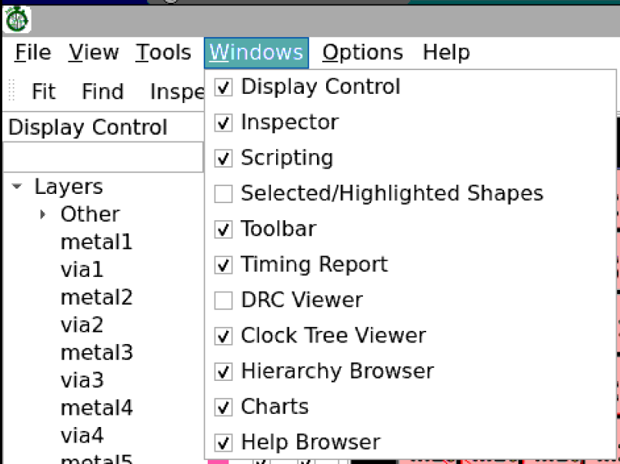


Clock Tree Viewer
Open GUI
gui::show
Enable “Clock Tree Viewer” if not enabled
Clock tree viewer shows latencies at all sinks
Red sinks = FF/latches
Green sinks = macros
Insertion delays are added to macro sinks
Kahng ECE 260C SP25
Thanks: Dr. Cho Moon, Precision Innovations

Slide 51
Generalized H-Tree Concept
Structured clock trees
K. Han, A. B. Kahng and J. Li, "Optimal Generalized H-Tree Topology and Buffering for High-Performance and Low-Power Clock Distribution", IEEE Transactions on Computer-Aided Design of Integrated Circuits and Systems https://vlsicad.ucsd.edu/Publications/Journals/j128.pdf.
 | H-tree | Fishbone
Skew | <
Wirelength | >
Latency | >
Power | >
H-tree
“Fishbone”
Generalized H-tree (GH-tree)
Can we mix two clock structures to have better tradeoff between clock power vs. skew or latency?
History: (1) Bakoglu’s 1988 book made H-tree approach well-known. Cadence CTGen (Dr. Lars Hagen), mid-1990s, started trend toward “fishbone” style – save capacitance!
These days: on-chip variation (OCV) derates are costly, so goal is to reduce insertion delay (== “latency”).
Kahng ECE 260C SP25
Notes:
In this slide, I will explain the motivation of our generalized H-tree.
[Click] Among tree-based topologies, H-tree provides the best skew at the higher cost of wirelength, latency and power. On the other hand, fishbone-like clock tree provides better WL, latency and power, but larger skew compared to H-tree.
[Click] Given these two extreme tree topologies, could we mix these two clock structures to have better tradeoff between clock power versus skew or latency?
[Click] In this work, we define generalized H-tree as a balanced tree topology with arbitrary branching factor at each level. In this figure, we shows a depth 8 GH-tree and its branching factors are 4 2 2 2 4 2 2 2 from top to bottom.

Slide 52

Generalized H-Tree Concept
Structured clock trees
K. Han, A. B. Kahng and J. Li, "Optimal Generalized H-Tree Topology and Buffering for High-Performance and Low-Power Clock Distribution", IEEE Transactions on Computer-Aided Design of Integrated Circuits and Systems https://vlsicad.ucsd.edu/Publications/Journals/j128.pdf.
 | H-tree | Fishbone
Skew | <
Wirelength | >
Latency | >
Power | >
H-tree
“Fishbone”
Generalized H-tree (GH-tree)
a balanced tree topology
with arbitrary branching
factor at each level
GH-tree with depth P = 8 and branching factors (4, 2, 2, 2, 4, 2, 2, 2)
Kahng ECE 260C SP25
Notes:
In this slide, I will explain the motivation of our generalized H-tree.
[Click] Among tree-based topologies, H-tree provides the best skew at the higher cost of wirelength, latency and power. On the other hand, fishbone-like clock tree provides better WL, latency and power, but larger skew compared to H-tree.
[Click] Given these two extreme tree topologies, could we mix these two clock structures to have better tradeoff between clock power versus skew or latency?
[Click] In this work, we define generalized H-tree as a balanced tree topology with arbitrary branching factor at each level. In this figure, we shows a depth 8 GH-tree and its branching factors are 4 2 2 2 4 2 2 2 from top to bottom.

Slide 53

Idea: Capture/Explore Tradeoff (“Pareto” Frontier)
(Recall: floorplan shape functions ?)
Kahng ECE 260C SP25
Notes:
Here is the problem statement.
Given a placement solution with timing library, the objective is to construct GH-tree with co-optimization of the clock tree topology and buffering to minimize clock power.
Constraints are max clock skew, latency, transition time and load.

Slide 54
Also: Routing to IOs: pad (ICeWall)
Kahng ECE 260C SP25

Slide 55


SOC Integration and Planning: ICeWall Padring Gen
Starts with:
Verilog netlist with signal IO pads for simulation and STA
Power/ground IO cells may be present
IO cell data (signal, P/G, fillers, …) from library documentation
Footprint file defines where each padcell is to be placed in the padring – supports reuse of pre-existing padframes
Signal mapping file defines which signal in the Verilog is to be associated with which padcell in the padring
+ Auto-assignment capability in ICeWall
Decouples footprint and signal mapping for padframe reuse
DEF
Verilog
Signal
Mapping
ICeWall: Extract Footprint
Synthesis
Footprint
Definition
OpenROAD
ICeWall: Init Floorplan
IO Library
Data
IO Library
Documentation
Kahng ECE 260C SP25
Thanks: Colin Holehouse, Arm
Notes:
Objective:
Encapsulate the rules of the technology and IO library to minimize the amount of information that needs to be provided to construct a clean padring
This functionality is not available in commercial EDA tools; each padring is a bespoke construction using low-level floorplanning functionality
Can be used to build padrings with several different types of bondpad solution:
Wirebond with integrated or separated bondpad instances
Wirebond with staggered pads
Flipchip bondpads, with central bump array dedicated to core P/G and edge bumps a mixture of signal and P/G (for core and IO)
A footprint defines the location of all the padcells in the design, it can be extracted from a DEF of a different chip that has the same number (or fewer) signal IOs defined and had a core area large enough to accommodate this design. It can be used as is, or as a starting point for the designer to make adjustments to the IO ring.
The IO library comes with detailed documentation. It is a manual task to distill this information into an IO Library Data file for use by ICeWall. This file may be re-used for different chips that use the same IO library.
The signal mapping file associates signals in the Verilog design with padcells in the Footprint definition. If no signal mapping is provided, ICeWall will allocate the IOs of the Verilog design to the signal pads in the footprint definition

Slide 56



ICeWall Padring Examples
What designers ask for …
Determining the number of required P/G pads to be provided as callback functions to allow to encapsulate specs from library documentation
Definition of padring segments for analog signals, PHYs, different IO voltages, etc.
Definition of control cells that are required on a per-IO cell basis
GF12LP BP-1, staggered pads
GF12LP BP-1, as a flipchip
SKY130 coyote, + pads
Kahng ECE 260C SP25
Thanks: Colin Holehouse, Arm

Slide 57
Also: GPU-Accelerated GRT
Kahng ECE 260C SP25

Slide 58


Summary of Previous Methods
2D-GPU-accelerated GRs are based on FastRoute4.1
SPRoute and SPRoute2.0: implement parallel maze routing
3D-GPU-accelerated GRs are based on CUGR
FastGR and GGR: implement parallel L/Z-shape pattern routing
GAMER and GGR: implement parallel maze routing
Replace the A* search algorithm with the parallel n-bend pattern routing algorithm
Route a batch of non-overlapping nets concurrently !
FastGR / GGR
GAMER / GGR
Runtime Bottleneck
2D GR Flow
3D GR Flow
Kahng ECE 260C SP25
Thanks: Dr. Zhiang Wang
Notes:
Roughly speaking, global routers can be divided into two categories: 2D GR and 3D GR.
[click] 2D GR compresses routing layers onto a 2D plane,
builds a 2D routing graph and routes on the 2D plane followed with layer assignment.
2D-GPU-accelerated GRs are based on FastRoute.
[click] 3D GR routes directly on multiple metal layers.
3D-GPU-accelerated GRs are based on CUGR.
[click] The runtime bottleneck for both 2D GR and 3D GR is the maze routing.
[click] The key idea of all previous GPU GRs is to route a batch of non-overlapping nets concurrently !
Here the non-overlapping nets means that there is no overlap between their bounding boxes.
[click]
Before we jump into our work, let’s take a step back and talk about some brief history of routing.
Routing often adopt a two-stage approach – global routing, followed by detailed routing. Such a two-step approach allow research effort to focus on one stage at a time to boost progress.
[click] What we hoped was to push [click] both global routing and detailed routing move forward [click] and they should still stay together. [click] [click] [click]
[click] However, this is not how reality looks like. [click] both global routing and detailed routing are moving forward [click] [click], in slightly different directions [click] [click] . Until [click] there is a crack between them, and [click] they don’t talk anymore.

Slide 59

Proposed GPU-Accelerated TritonRoute-GR
Our GPU-GR is based on TritonRoute-GR
TritonRoute-GR adopts a two-step approach (2D + 3D GR)
2D global routing can effectively reduce the solution space
3D global routing can further optimize the solution locally
Replace the original 2D-RRR and 3D-RRR with corresponding GPU-accelerated GPU-RRR
Clip-based
2D GPU-RRR
Clip-based
3D GPU-RRR
Kahng ECE 260C SP25
Thanks: Dr. Zhiang Wang
Notes:
Our GPU-GR is based on TritonRoute-GR.
[click] TritonRoute-GR adopts a two-step approach.
More specifically, TritonRoute-GR first performs 2D global routing, which effectively reduce the solution space.
Then, TritonRoute-GR performs 3D global routing to further optimize the solution locally.
[click] In our GPU-accelerated implementation, we replace the original 2D-ripup-and-reroute and 3D-ripup-and-reroute with corresponding GPU-accelerated ripup-and-reroute.
[click]

Slide 60

Current Approach
Unified Resource Model
Routing tracks
Design rules
Pin accesses
Parallel pattern
routing proposed by FastGR
Three-level parallel maze
routing using parallel
bidirectional A* search
Kahng ECE 260C SP25
Thanks: Dr. Zhiang Wang
Notes:
In this slide, we present the flow of our GPU-GR.
[click] Firstly, we use the unified resource model, which considers the routing tracks, design rules and pin accesses.
[click] Then, in the initial global routing stage, we perform parallel pattern routing proposed by FastGR.
[click] Finally, we perform three-level parallel maze routing using parallel bidirectional A* search.
The red boxes represent the modified elements in the original TritonRoute-GR.
[click]

Slide 61



Three-Level Parallel Maze Routing
We adopt three-level parallel maze routing
Level 1: maze routing for all the nets in a single clip $↔$ Grid on GPU
Level 2: maze routing for a single net $↔$ Block on GPU
Parallel A* search based on multiple priority queues [ZhouZ'15AAAI]
Level 3: expansion for a single priority queue $↔$ Thread on GPU
Single priority queue
Level 3
Parallel bidirectional A* search
Maze routing
for a single net
Level 2
Nonoverlapping nets
Maze routing for all
the nets in a single clip
Level 1
Divide the routing region
into multiple non-overlapping
Clips (200 x 200 gcells)
Single GPU
CUDA Programming Model
Design Maze Routing
Kahng ECE 260C SP25
Thanks: Dr. Zhiang Wang
Notes:
In this slide, we present the three-level parallel maze routing approach.
As shown in the figure, the GPU architecture has three levels of parallelism. It organizes threads (the smallest execution units) into blocks, and blocks into grids.
[click] Threads is the basic unit of execution in CUDA. Each thread has its own set of registers and can execute independently.
CUDA GPUs execute threads in groups called wraps (usually 32 threads), where each thread in a wrap executes the same instruction at a time but can operate on different data.
[click] A block is a group of threads that execute the same kernel (a function executed on the GPU) and can share data through shared memory.
[click] A grid is a collection of blocks that are executing the same kernel. The idea is that the grids represent the entire problem space, and each block within the grid can work on a portion of the problem independently. We naturally map the GPU-GR problem into three levels of parallelism.
[click] In the first level, the entire netlist is divided into multiple clips. Each clip is represented by a grid on the GPU. A grid will take care of all the nets in the clip;
[click] In the second level, each net in a clip is represented by a block. The routing kernel function is defined for each net.
We will apply the GPU-accelerated Bidirectional A* search for each net.
Here we use the multiple priority queues to accelerate the expansion process.
[click] In the third level, each priority queue is mapped to a single thread on GPU.
Currently, we are still working on the implementation and will submit this work to ICCAD at May.
[click]

Slide 62

Future Work
“machine learning alongside optimization algorithms”
Combine the detailed-routability-driven GR with the ML-based DRV prediction models
Improve accuracy and robustness compared to “end to end learning”
Kahng ECE 260C SP25
Thanks: Dr. Zhiang Wang
Notes:
In this slide, we talk about the ML-enhanced GR.
We use the idea of machine learning alongside optimization algorithms.
[click] As shown in the red arrows in this figure, we combine the detailed-routability-driven GR with the ML-based DRV prediction models.
[click] This method can improve accuracy and robustness compared to widely used “end-to-end learning”.
[click]

Slide 63
BACKUP
Kahng ECE 260C SP25

